Slide 1

Effective Visualization I
Lab 4
One of the classic blunders:
“Never get involved in a land war in Asia”
Charles Joseph Minard, Paris, 1869

Slide 2
Agenda
Principles of effective visualization
Color and color scales
ggplot intro
Next time:
Image files (raster and vector, resolution)
Putting data on maps

Slide 3
Recommended resources
Claus Wilke’s Fundamentals of Data Visualization
Hadley Wickham et al.’s ggplot2 Book
Winston Chang’s R Graphics Cookbook
ggplot2 Cheat Sheet
design concepts
R graphing philosophy
“how do I make this plot?”

Slide 4
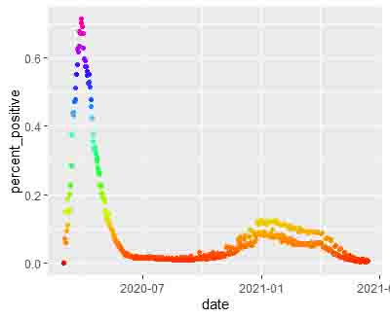

Slide 5
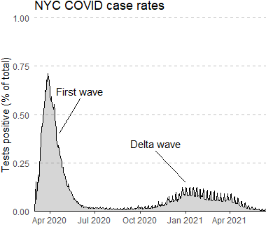

Slide 6
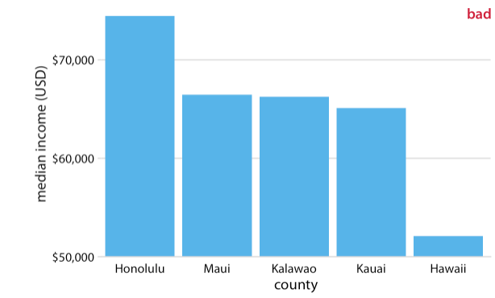
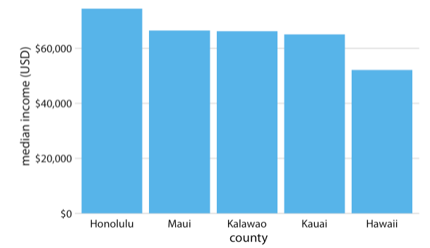
Tell the truth

Slide 7
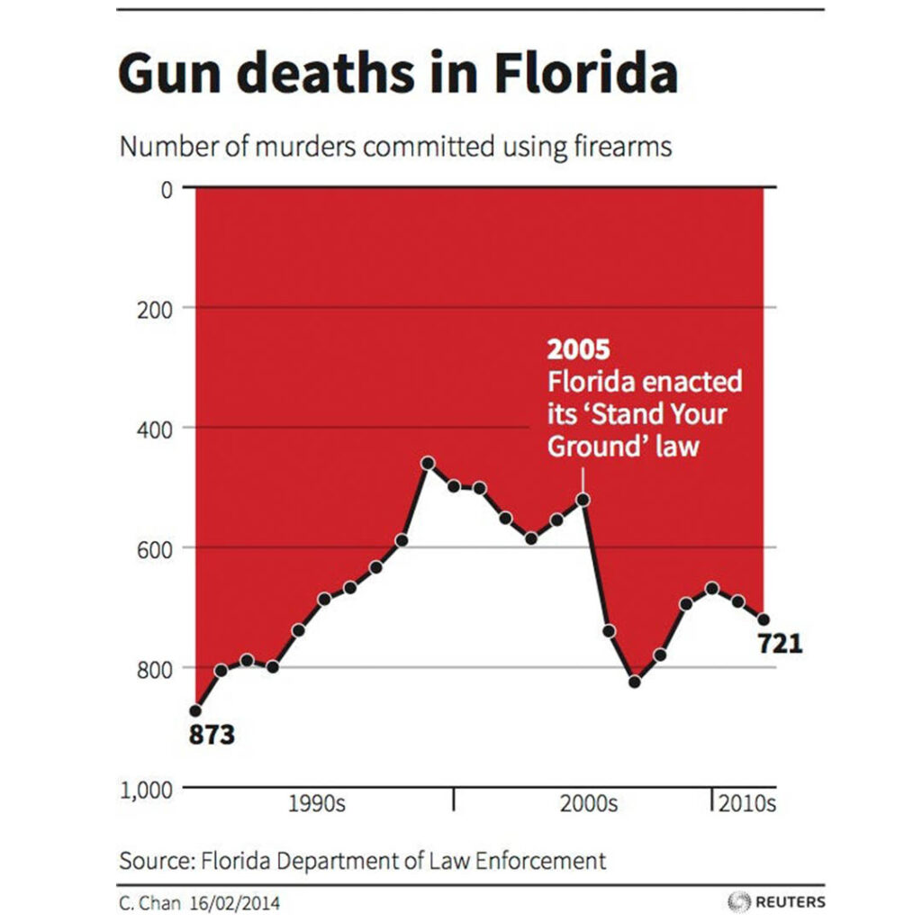
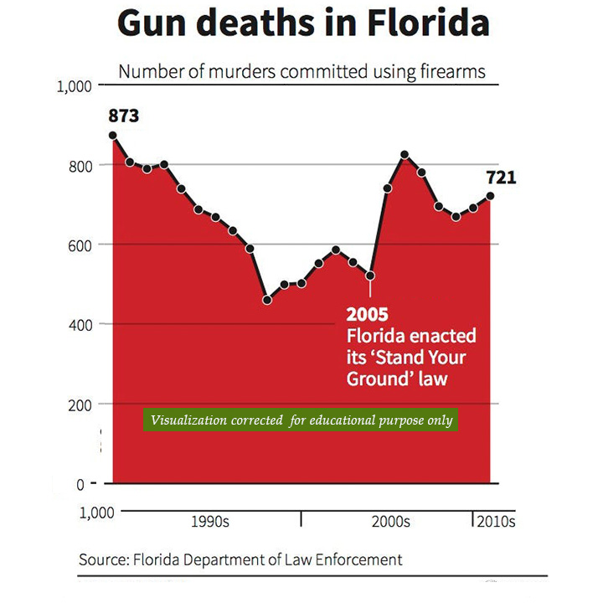
Tell the truth

Slide 8
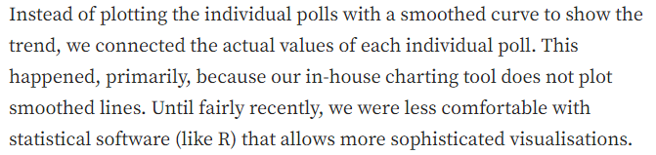
Tell the truth
The Economist owns up to visualization mistakes
Poor carpenters blame their tools

Slide 9
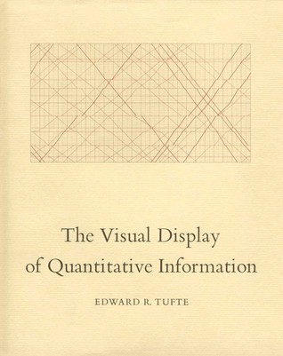
Data-ink ratio and chartjunk
Data-ink
Data-ink ratio =
Total ink used to print the graphic
=
1 – proportion of a graphic that can be erased

Slide 10
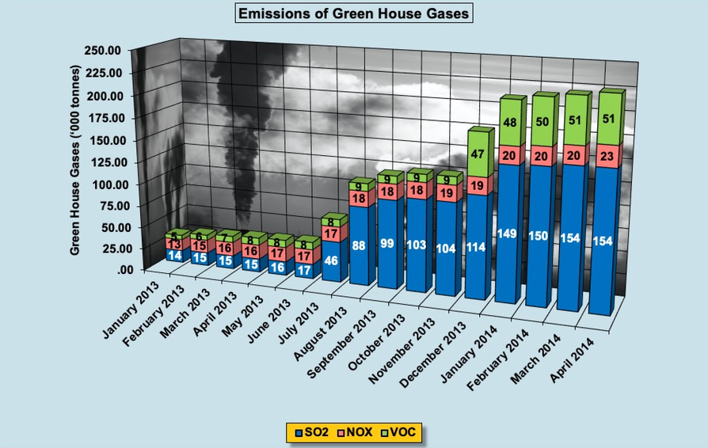
Data-ink ratio and chartjunk

Slide 11
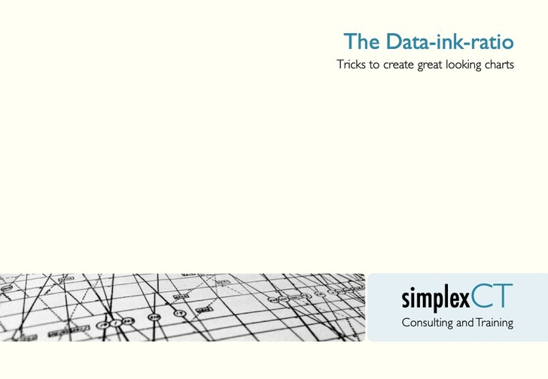
Data-ink ratio and chartjunk

Slide 12
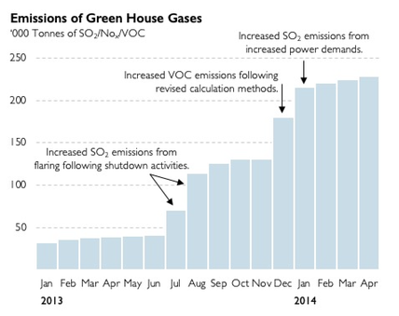
Data-ink ratio and chartjunk

Slide 13
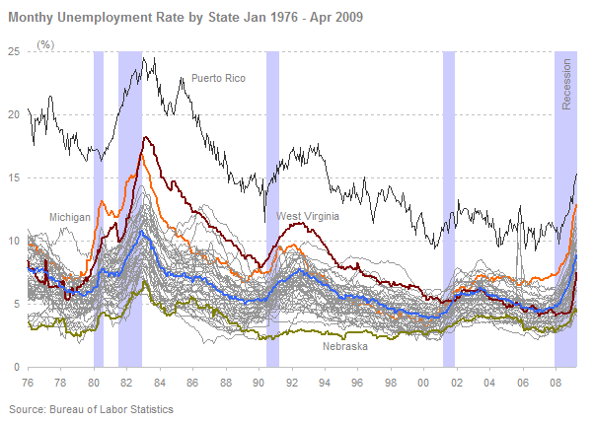
Multivariate data – small multiples

Slide 14
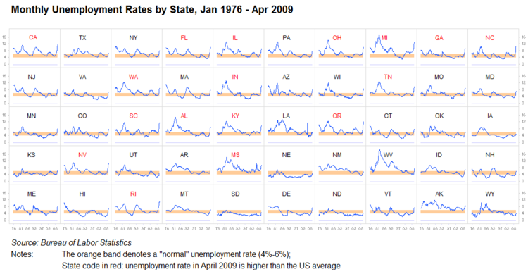
Multivariate data – small multiples

Slide 15
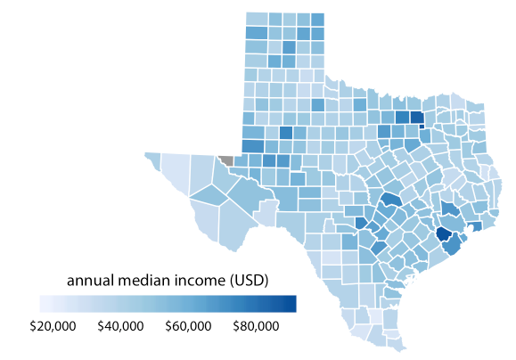
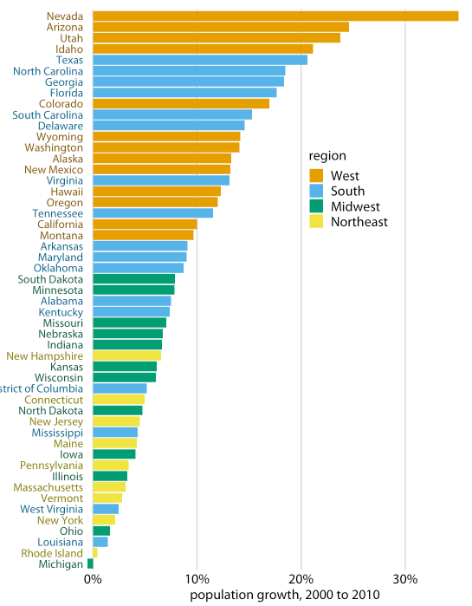
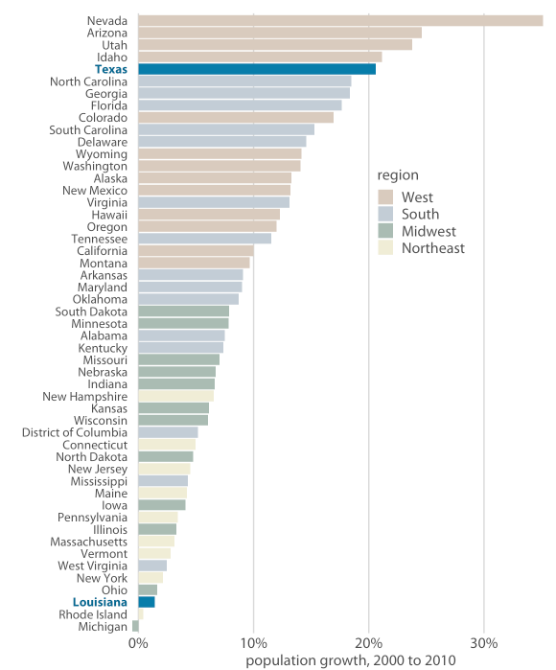
When to use color?
Will my figure benefit from color?
Use color to:
Distinguish groups
Represent data values
Emphasize visual elements

Slide 16
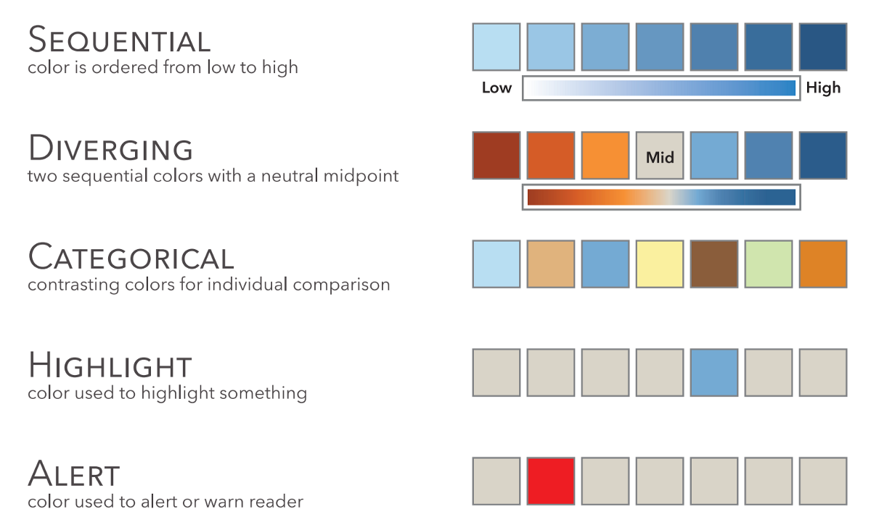
Types of color scales

Slide 17

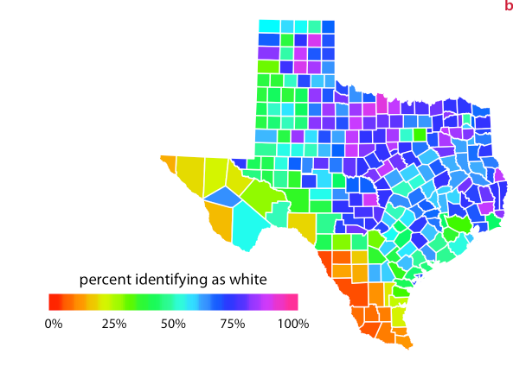
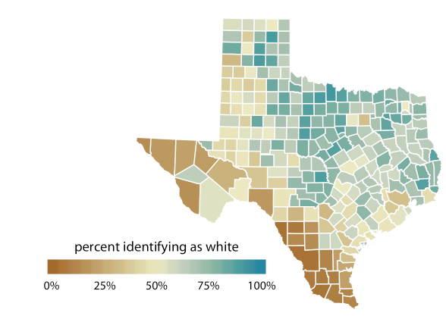
Beware the rainbow

Slide 18
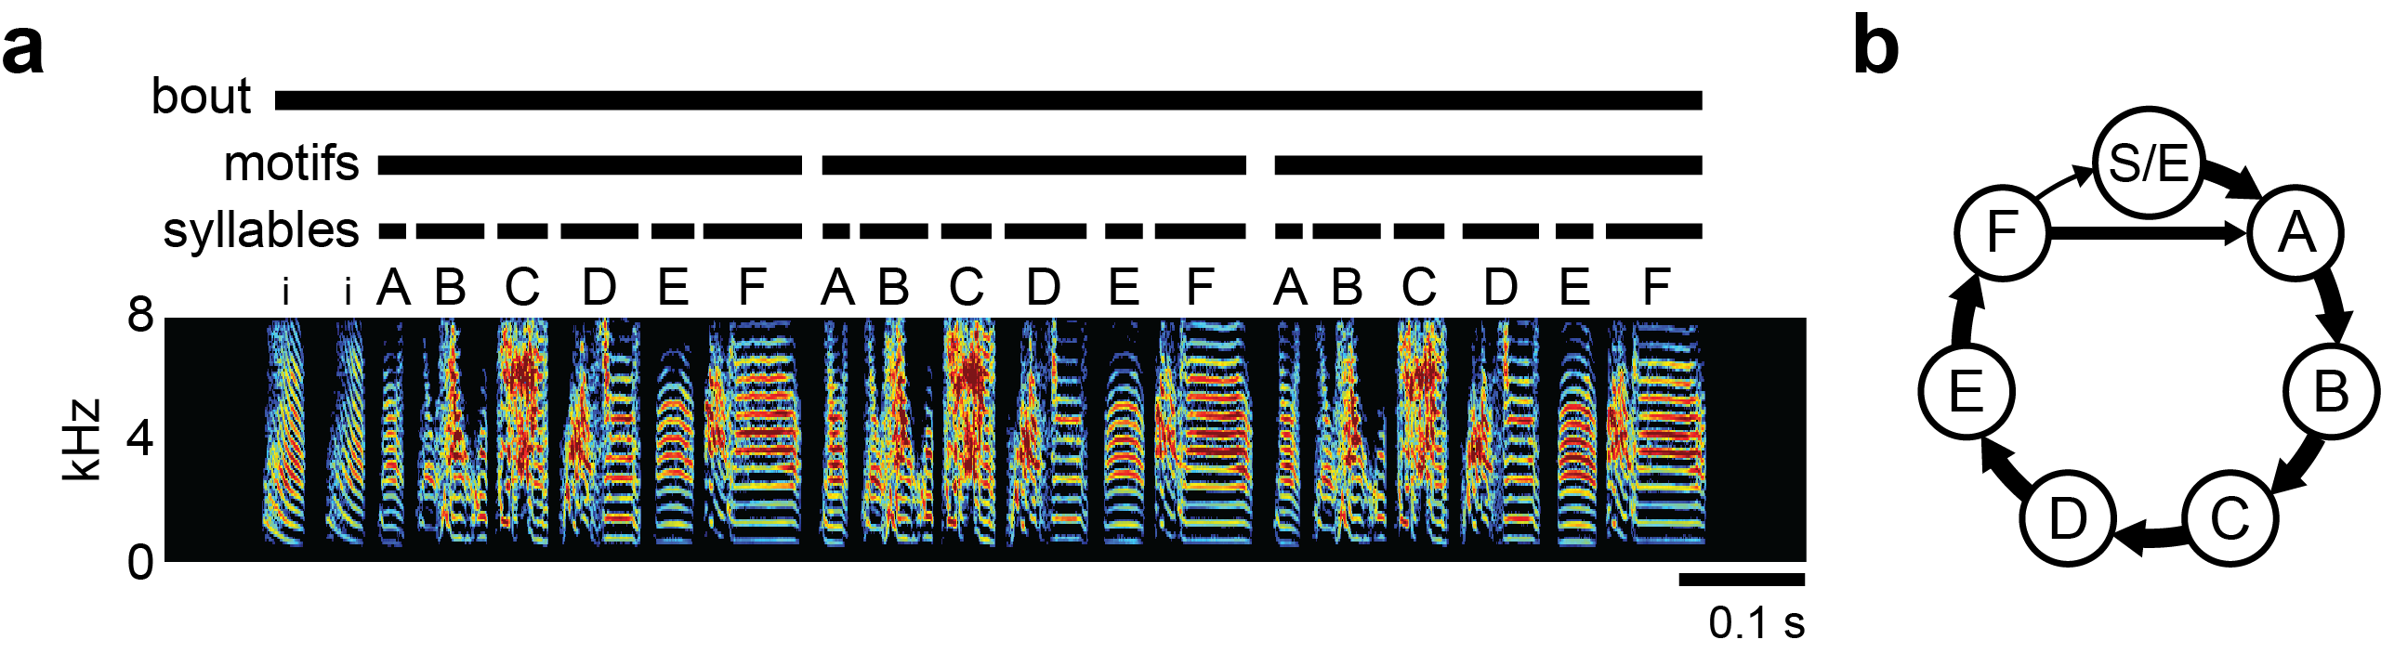
Beware the rainbow (unless your boss wants it)
Notes:
Figure from a paper Jacob is working on – the image uses the “rainbow” color scheme, with values of 0 set to black
Jacob isn’t too fond of the color scale, but the lab has been using it for these types of images for years – sometimes you have to pick your battles

Slide 19
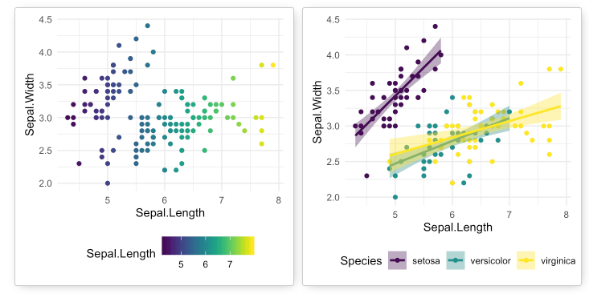
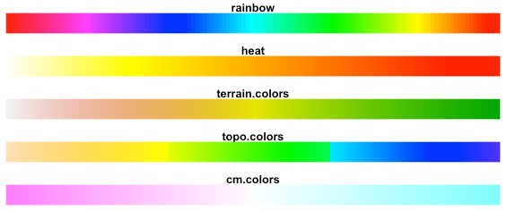
Color and palette resources
Top R Color Palettes to Know
Kenneth Moreland’s Color Advice (highly recommended!)

